Slide 1
Related Rates:
Falling ladders, Inflating Balloons, Lengthening Shadows,
Draining Tanks.
Another use of the Chain Rule:
find the rates of change of two or more related variables that are changing with respect to time.
cthiel@sfhs.net

Slide 2
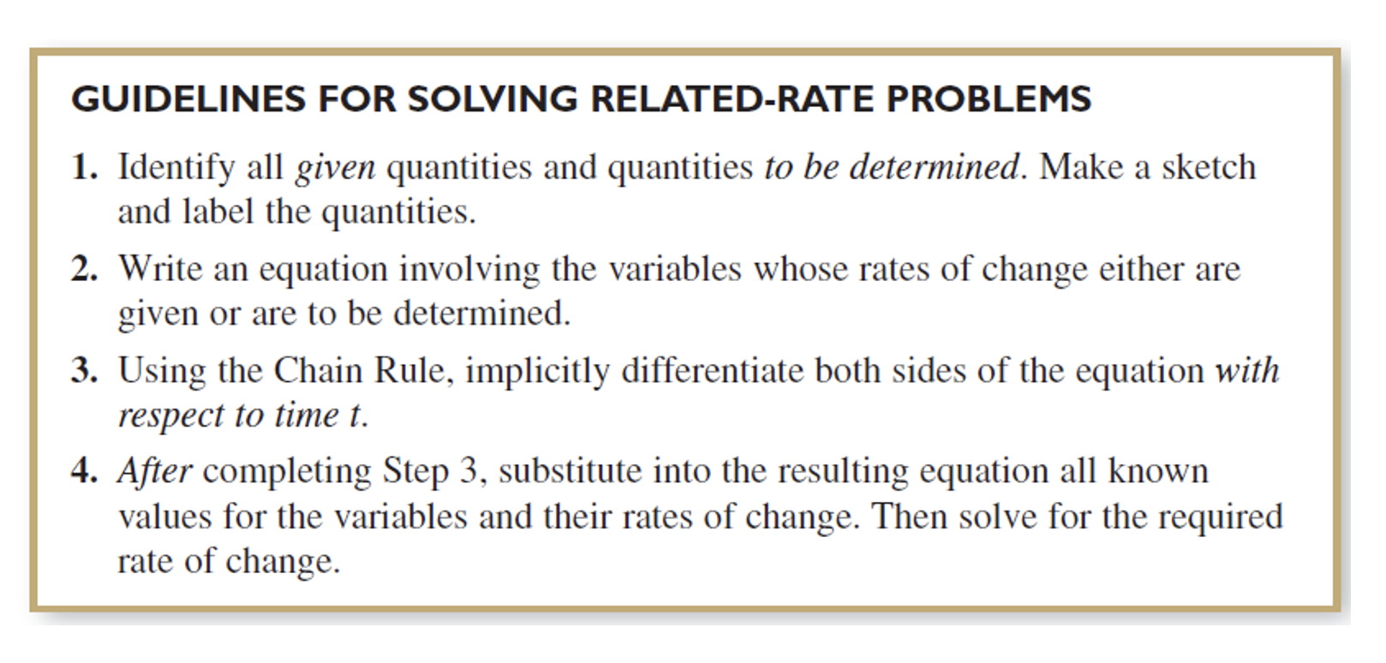
The textbook's 4 Guidelines......
but word problems need some translation into
our "math-y" way of solving for unknowns....

Slide 3
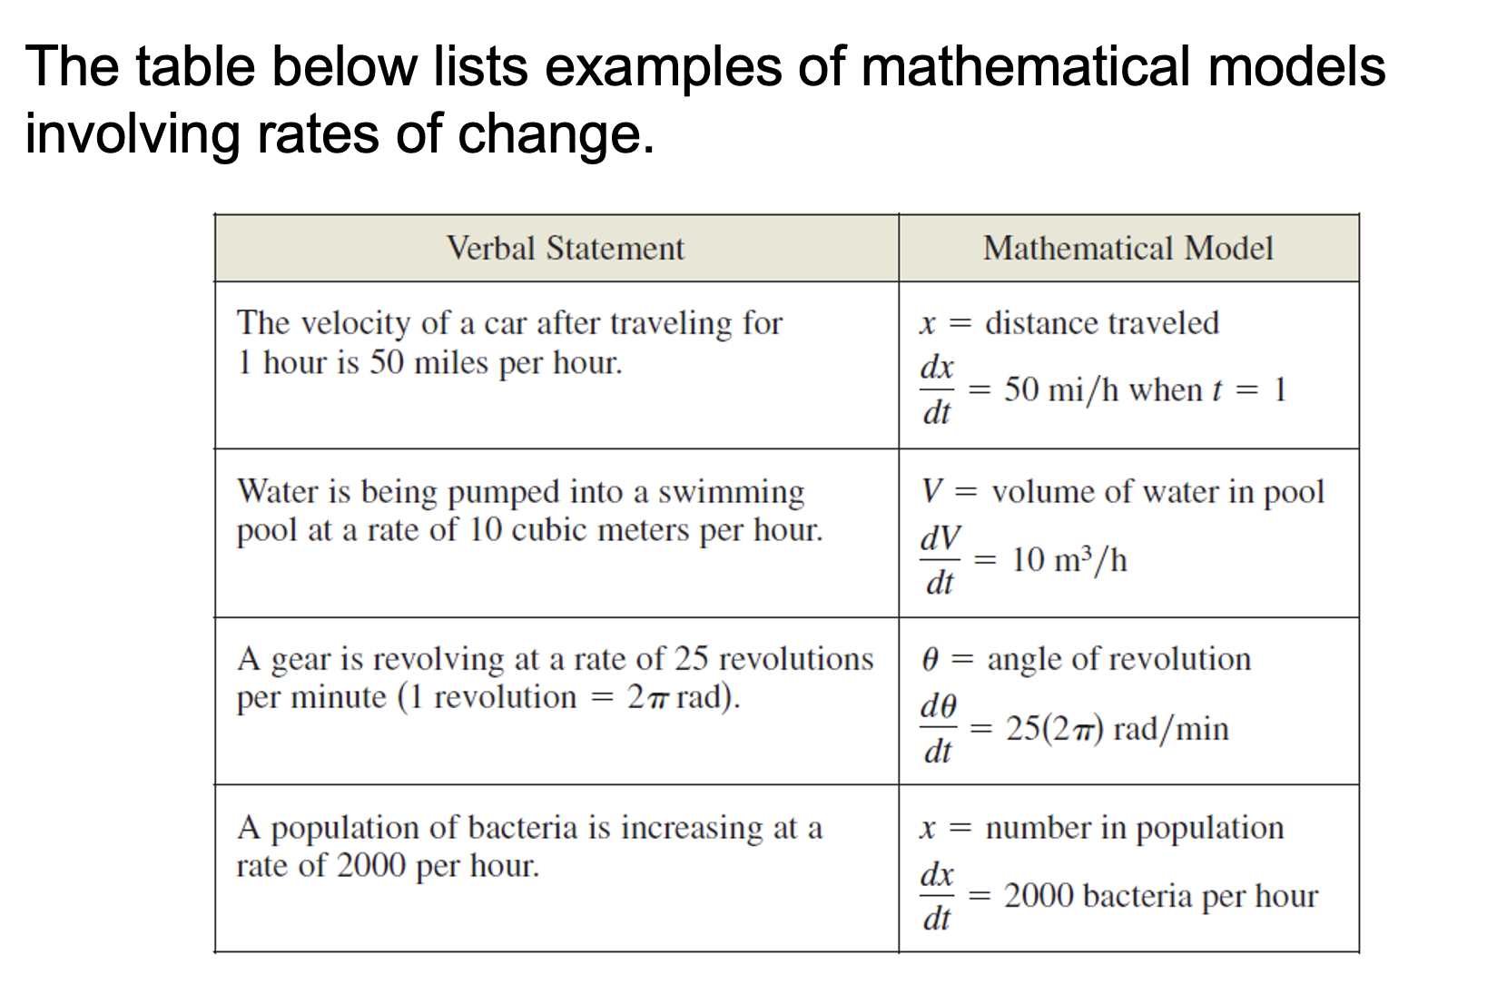

Slide 4
5 Steps to Related Rates:
1: What are you given? (think of units)
2. What are you asked for? (think of units)
3: What equation(s) connect these?
4: Implicitly Differentiate ( d/dt )
5: Evaluate @ known value (think of units)

Slide 5
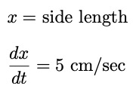
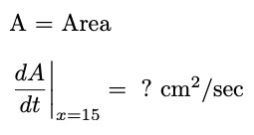



The sides of a square are increasing at a rate of 5 cm/sec.
How fast is the area increasing when the sides measure 15 cm in length?
1: What are you given? (think of units)
2. What are you asked for? (think of units)
3: What equation(s) connect these?
4: Implicitly Differentiate ( d/dt )
5: Evaluate @ known value (think of units)
The area is increasing at rate of 150 square
centimeters per second when the side reaches 15 cm in length

Slide 6


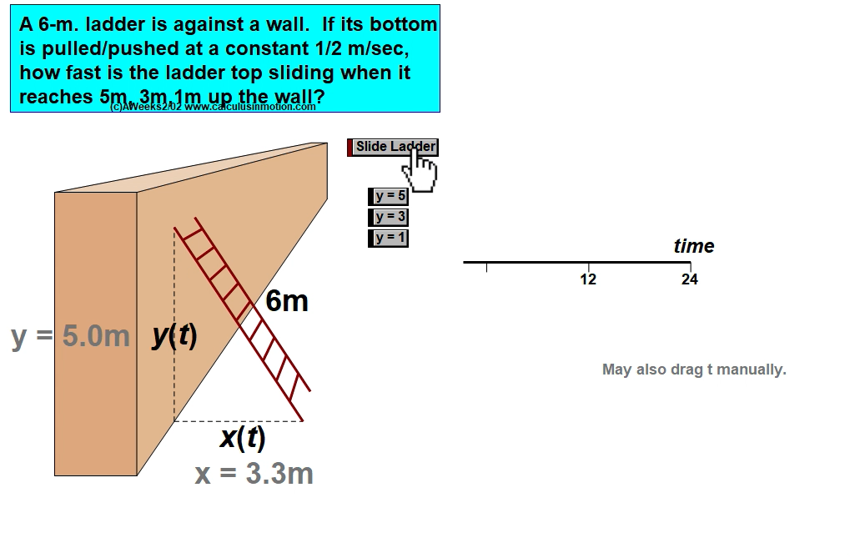

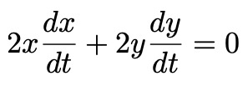
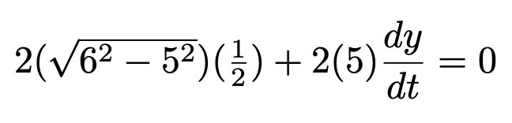

Falling Ladders
A 6 meter ladder is against a wall. The top end of the ladder is sliding down the wall as the bottom is being moved. When the top end is 5 meters from the ground it is being pulled away from the wall at a rate of 1/2 meter per second. How fast is the ladder top sliding when the top of the ladder is 5 meters from the ground?
1: What are you given? (think of units)
2. What are you asked for? (think of units)
3: What equation(s) connect these?
4: Implicitly Differentiate ( d/dt )
5: Evaluate @ known value (think of units)
The ladder is sliding down the wall at a rate of about 0.332
meters per second.

Slide 7









A 10 meter ladder is against a wall. The top end of the ladder is sliding down the wall. When the top end is 6 meters from the ground it is sliding down at 2 meters per second. How fast is the bottom moving away from the wall at this moment?
1: What are you given? (think of units)
2. What are you asked for? (think of units)
3: What equation(s) connect these?
4: Implicitly Differentiate ( d/dt )
5: Evaluate @ known values (think of units)
The bottom of the ladder is moving away from the wall
at a rate of 1.5 meters per second when
the height of the ladder is 6 meters from the ground

Slide 8
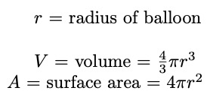
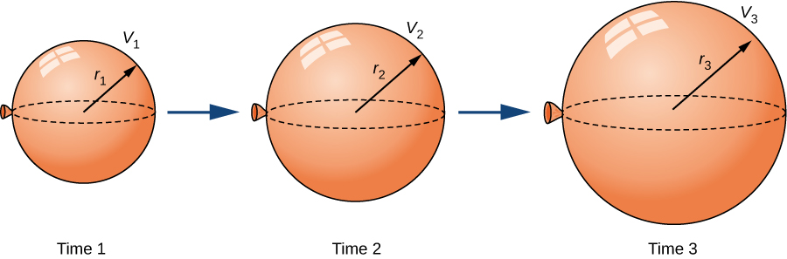








A spherical Balloon is being inflated at a rate of 10 cubic centimeters per second. Find the rate of change of the surface Area of the Balloon at the moment when the surface area is 64π square centimeters.
1: What are you given? (think of units)
2. What are you asked for? (think of units)
3: What equation(s) connect these?
4: Implicitly Differentiate ( d/dt )
5: Evaluate @ known values (think of units)
The surface area of the balloon is increasing at the rate of 5 square centimeters per second
when the surface area of the balloon is 64π square centimeters

Slide 9

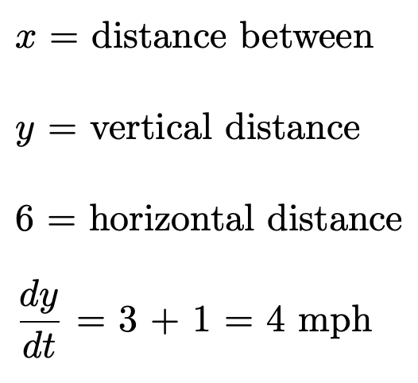
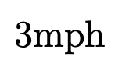






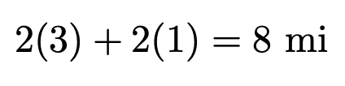
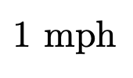
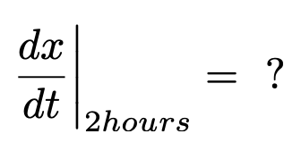

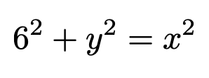
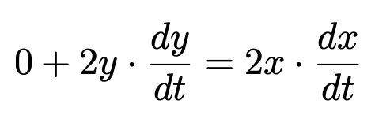
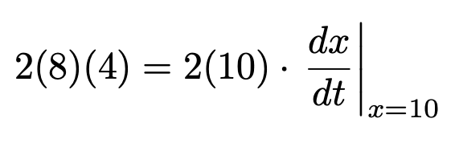
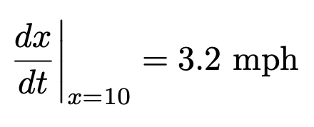
Joe is standing 6 miles due east of Moe. If Joe walks due North at 3 mph while Moe walks due south at 1 mph, at what rate is the distance between them changing after 2 hours?
1: What are you given? (think of units)
2. What are you asked for? (think of units)
3: What equation(s) connect these?
4: Implicitly Differentiate ( d/dt )
5: Evaluate @ known value (think of units)
After 2 hours, the distance between Joe and Moe
is increasing at a rate of 3.2 mph

Slide 10
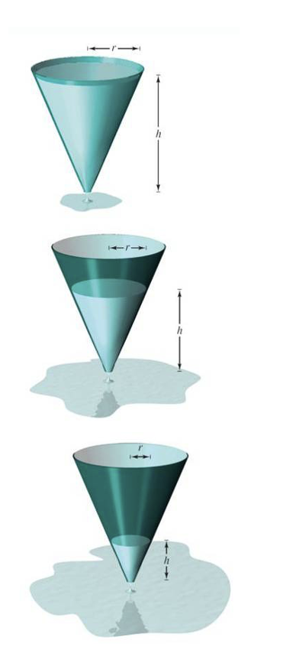



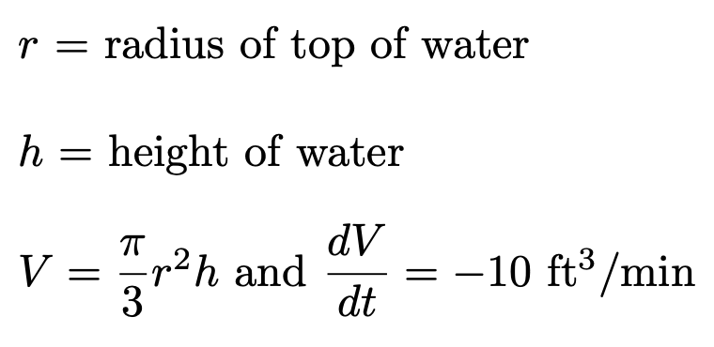
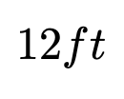

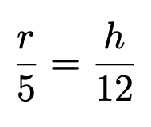
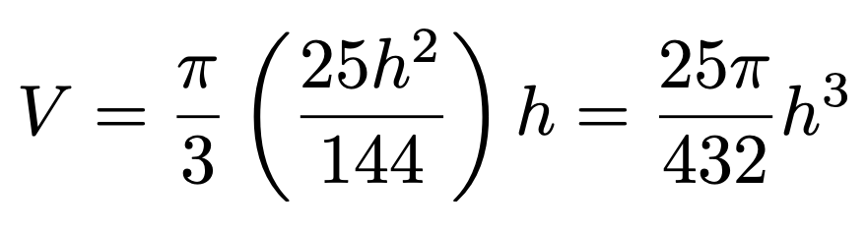
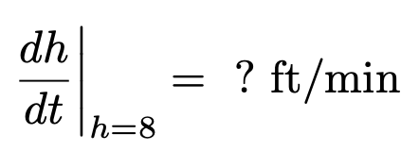
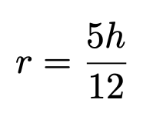
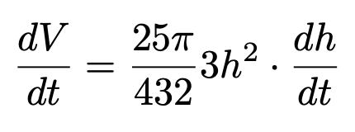
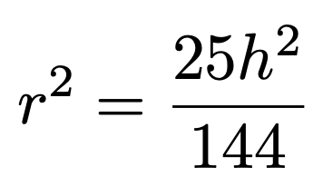
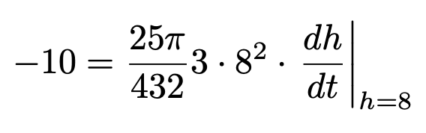
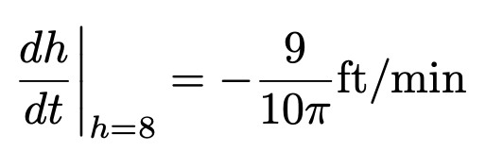
Water is drained out of a full conical tank that measures 10 feet across the top and 12 feet deep. If the water is draining out at the rate of 10 cubic feet per minute, what is the rate of change of the depth of water when the depth is 8 feet?
1: What are you given? (think of units)
2. What are you asked for? (think of units)
3: What equation(s) connect these?
4: Implicitly Differentiate ( d/dt )
5: Evaluate @ known value (think of units)
The water is draining at a rate of 9/10π (about 0.286) feet per minute
(3.438 inches/minute) when the water depth is at 8 feet.

Slide 11
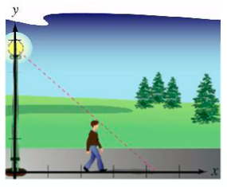
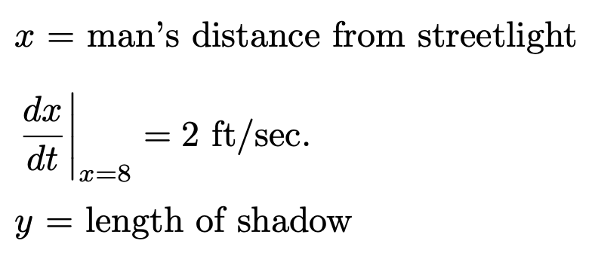

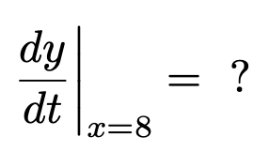
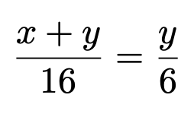
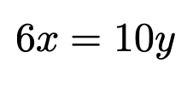
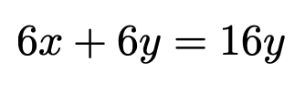
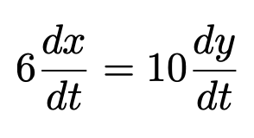
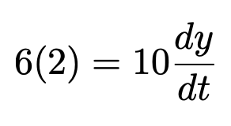
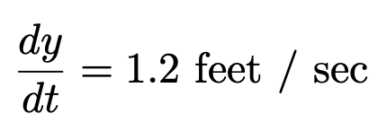
A 6 feet tall man walks away from a 16 foot street light at a rate of 2 feet per second. As he walks, the shadow lengthens. When he is 8 feet from the streetlight, what is the rate at which the shadow is lengthening?
1: What are you given? (think of units)
2. What are you asked for? (think of units)
3: What equation(s) connect these?
4: Implicitly Differentiate ( d/dt )
5: Evaluate @ known value (think of units)
The length of the shadow is growing at a rate of 1.2 feet per second.

